Slide 1
Acquisitions and IPOs
SQL and Excel Project
Presentation By
Pankaj Kumar

Slide 2
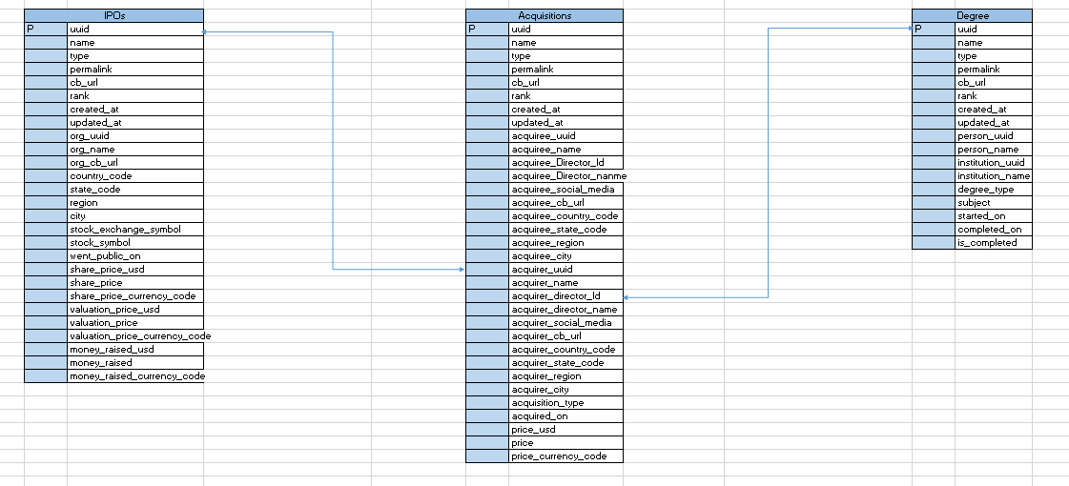
About Data
Size of Dataset:-
No. of Columns in each table - 20 (Avg.)
Entry in each Table- 70
Key Tables- Acquisitions, IPOs, Degree
Information:-
Acquisitions
IPOs
About Acquirer and Acquiree
About Valuation
Directors Qualifications
Objectives:-
See whole sum Insights about Acquisitions and IPOs
Finding distributions between companies having IPOs vs don’t having IPOs
Regional Analysis to see Which Countries are Leading in IPOs and Acquisitions
Monthly Analysis of Acquisitions and IPOs
Qualification Analysis of Directors
Analysis on Social Media Presence

Slide 3
Approach
For Analyzing Acquisitions and IPOs we connected two tables on the basis of acquisitions.acquirer_uuid= IPO.org_uuid
Extracted Column of( acquirer_uuid, org_uuid, acquiree_name, acquirer_name, acquirer_country_code, Type, price_usd, money_raised)
Make Bins In SQL for analysis the no. of Acquisition done in particular range
Created INNER JOIN between acquisitions.acquiree_Director_Id = Degree.person_uuid for Analysing the Qualifications and Institute of Director
For Analyzing no. of Acquisition from the director of Acquirer and Acquiree both having same Institute created INNER JOIN in table Acquisitions and Degree

Slide 4
Analysis on Acquirers who already did IPO vs who didn't
Distributions

Slide 5
Companies Who Raised Money From IPOs
Total IPOs raised From Market
$ 824M highest is $575M
elf Cosmetics | 63000000
PlanetOut, Inc. | 41850000
Quotient Biodiagnostics | 40000000
Shield Therapeutics | 32500000
Shurgard Self-Storage | 575000000
Thyrocare Technologies | 72000000
Grand Total | 824350000

Slide 6
Top Acquirer on the basis of Acquired Price
Top 5 Acquirer who did IPOs Top 5 Acquirer who did not IPOs
Total:- $ 3.57Bn Total:- $ 2.91Bn
Acquire Companies | Sum of price_usd
Gru Comedil S.r.l | 714236600
HDI Plastics | 735231420
Navistar Defense | 724734010
Numbers | 703739190
Union de Pharmacologie Scientifique Applique | 693241780
Grand Total | 3571183000
Acquirer Companies | Sum of price_usd
Acosta | 514785810
Cisco | 525283220
CVC Capital Partners | 872523190
StackPath | 493790990
Teva Pharmaceutical Industries | 504288400
Grand Total | 2910671610

Slide 7
Country of Acquirer

Slide 8
Regional Analysis of Acquirers and Acquirees
Highest Acquires Belongs to California and England 7
Highest Acquirees Belong to Catalonia 10

Slide 10
Price analysis of different acquisitions
Maximum Acquired price comes in $300-400M Price Range count 18

Slide 11
Monthly analysis of number of acquisitions and IPOs
Maximum Acquisitions Comes in January and April Month which is 10 and min. in September, 0
Maximum IPOs Comes in January Month which is 11 and min. in March, 1

Slide 12
Analysis of social media presence of acquirers vs acquirees
47 Acquirers have social media presence out of 70
42 Aquirees have social media presence out of 70

Slide 13
Qualification (Degree) Analysis of directors of acquiree vs acquirer
Most Popular Degree Among Both Acquiree and Acquirer is MBA

Slide 14
Institute Analysis of directors of acquirers vs acquirees
In Acquiree Stanford University and in Acquire University of Texas is Popular Institute

Slide 15
Acquisitions where both directors of acquirer and acquiree are from the same institute
Highest Acquisitions is 4 where both acquirer and acquiree are from Stanford University and University of North Texas

Slide 16
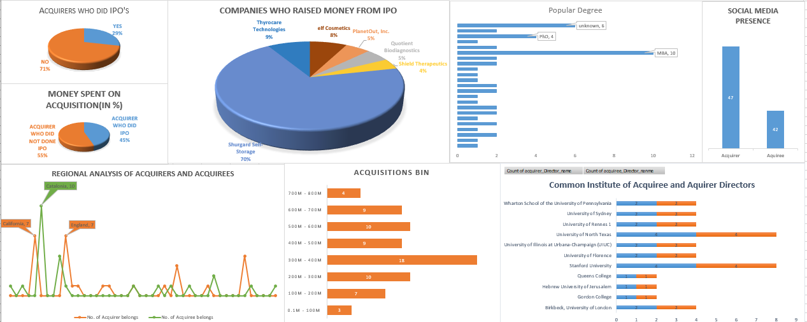
Acquisitions & IPOs Dashboard

Slide 17
Conclusions
29% of Acquirer Who did IPOs and Hold 45% Share on Total Acquisitions
71% of Acquiree Who did IPOs and Hold 55% Share on Total Acquisitions
Highest No. of Acquire Belongs from USA who did IPOs or Who Didn’t
Maximum Acquired price comes in $300-400M Price Range count 18
Highest Acquisitions is 4 where both acquirer and acquiree are from Stanford University and University of North Texas

Slide 18
Thank You

